Slide 1

ITSF 2018 –
Cyril DATIN R&D Manager
Hybrid OCXO as synchronization reference clocks
addressing harsh environmental conditions
©2018 Rakon Limited
June 2018

Slide 2


Electronic Circuits and Extreme Environments
In this presentation, extreme (harsh) environments refers to
  Extreme temperatures
  Temperature Cycles
  Shock and Vibration
Next generation Transport & Mobile equipment demand lower profile, higher performance
  Outdoor environments with temperature swings
=> Components operating at higher temperatures and harsher environments are required to address the thermal requirements of next generation equipment.

Slide 3
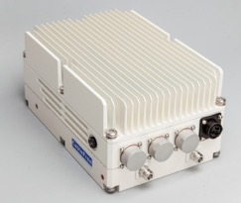

High temperature OCXO…Where?
5G wireless Equipment
  The dense deployment of 5G demands modular equipment configurations.
  Outdoor – Massive MIMO RRH – Classic example
  Weatherproof outdoor equipment requires fan-less, sealed enclosures designs
Front-haul/backhaul & Transport Equipment
  Massive power hungry devices (10s of Ks of Watt) overall
  Modularity enforces compact layout of high power elements on a Printed Circuit Board, introducing higher temperature levels
  PCB temperatures >80 degC ranges
Data center equipment
Industrial environments
  Inherently harsh environments
However moving to higher operating temperature system has some repercussion on overall reliability
This can be illustrated by Arrhenius law.

Slide 4

What does Arrhenius law mean?
The base failure rate is usually expressed by a model relating the influence of electrical and temperature stresses on a part.
One of the most characteristic parts of many models is the relation between temperature and failure rate. These models use thermal stresses in a form related to the Arrhenius Law.
$$A_{T}=e^{−\left(\frac{E_{aa}}{k}\right)\left(\frac{1}{T_{1}}−\frac{1}{T_{2}}\right)}$$
Where:
A_{T} is the acceleration factor due to changes in temperature;
E_{aa} is the apparent activation energy (eV);
k is Boltzmann's constant (8.62 × 10⁻⁵ eV/K);
T₁ is the absolute temperature of the test (K);
T₂ is the absolute temperature of the system (K).

Slide 5
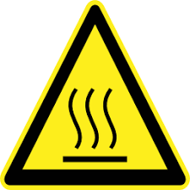
translating Arrhenius law to reliability
The hotter the worse the reliability will be …
Indeed:

Slide 6
How address high temperature design?
Due to internal residual power dissipation (oscillator, voltage regulation, buffer stage)
A minimum offset between the maximum surrounding temperature and the oven temperature shall be maintained
Depending on supply voltage, a 5°C offset is considered for safe operation
A 105°C environmental temperature means a 110°C oven temperature
Whatever temperature is, OCXO will be always at the hottest operation!
Max operating +85°C
Power (W)
95°C
115°C
Temperature (°C)
Max operating +105°C
Power (W)
95°C
115°C
Temperature (°C)

Slide 7
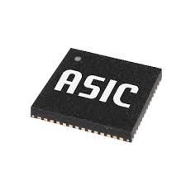
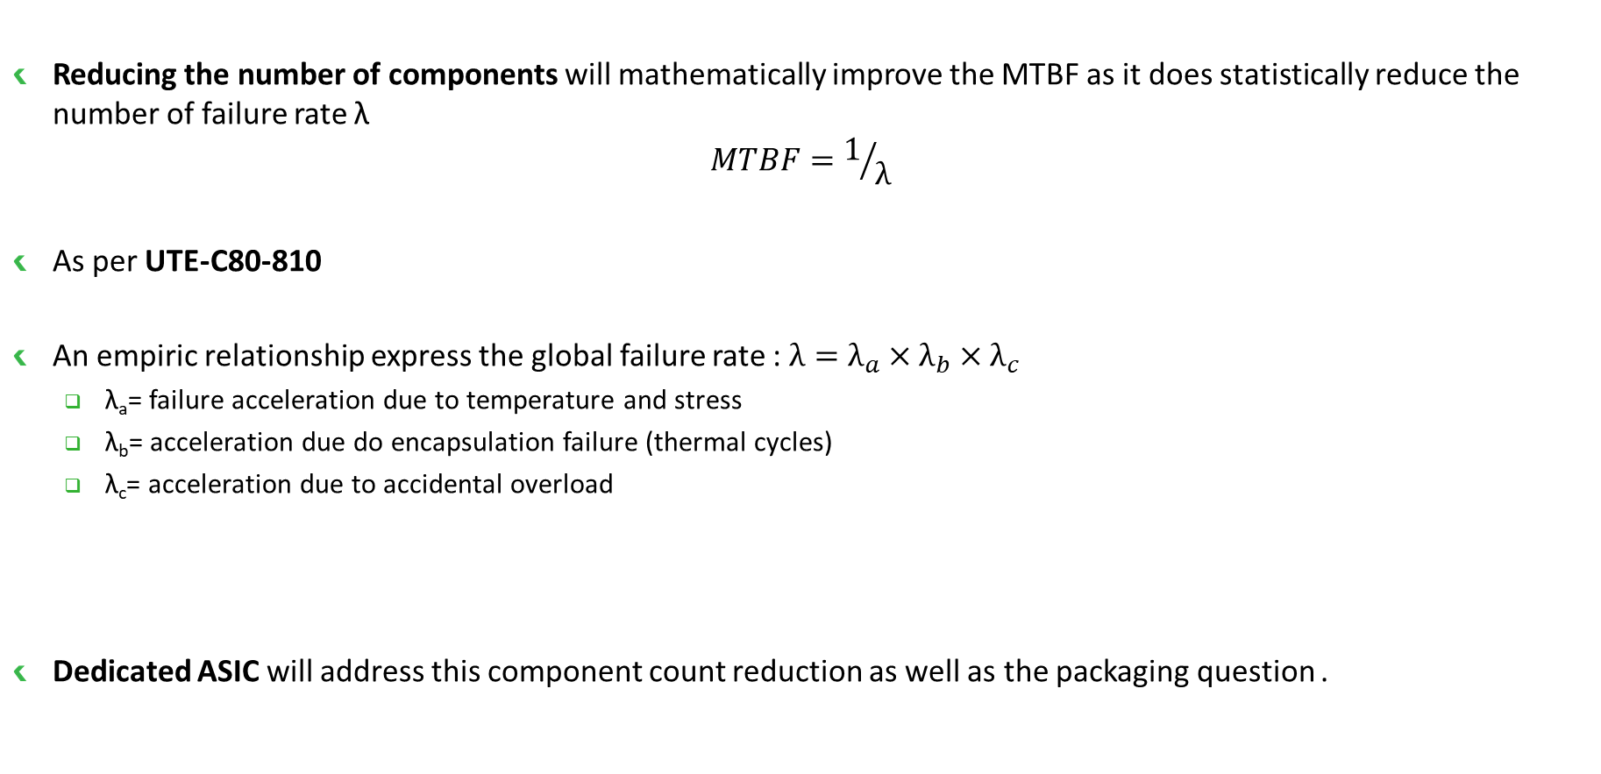
How achieve high reliability oscillator?
Reducing the number of components will mathematically improve the MTBF as it does statistically reduce the number of failure rate λ
$$MTBF=1/λ$$
As per UTE-C80-810
An empiric relationship express the global failure rate : $λ=λ_{a}×λ_{b}×λ_{c}$
  λ_{a}= failure acceleration due to temperature and stress
  λ_{b}= acceleration due do encapsulation failure (thermal cycles)
  λ_{c}= acceleration due to accidental overload
Dedicated ASIC will address this component count reduction as well as the packaging question .

Slide 8
Why Hybrid OCXO?
Putting together the best of the 2 worlds…!
Ageing performance
Frequency recovery/retrace
Overal thermal and mechanical sensitivity
High integration
High reliability
Power saving

Slide 9
What about Hybrid OCXO performance?
As network are more and more demanding for time keeping performance, more than ever XTAL oscillators need very high stability
What are the criteria that condition part final OCXO performances?
  Ageing
  Retrace
  Frequency recovery
  Short term stability
Short-term instability
(Noise)
df/f
5
10
15
20
25
Time (days)
X weeks
storage
Y days
OVEN
OFF
on
OVEN ON
4-5

Slide 10
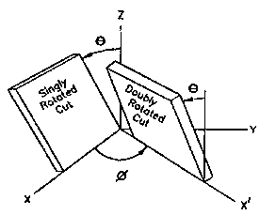
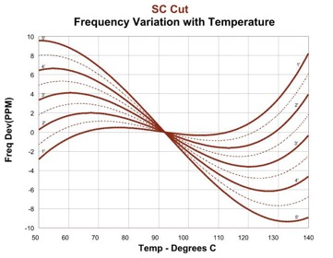

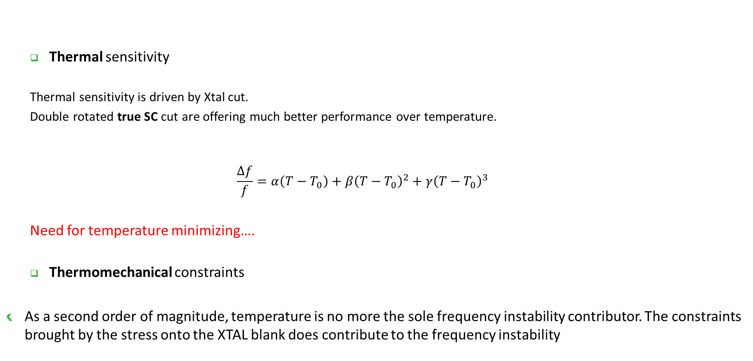
What about XTAL?
  Thermal sensitivity
  Thermal sensitivity is driven by Xtal cut.
  Double rotated true SC cut are offering much better performance over temperature.
  $$\frac{∆f}{f}=α\left(T−T_{0}\right)+β{\left(T−T_{0}\right)}^{2}+γ{\left(T−T_{0}\right)}^{3}$$
  Need for temperature minimizing….
  Thermomechanical constraints
As a second order of magnitude, temperature is no more the sole frequency instability contributor. The constraints brought by the stress onto the XTAL blank does contribute to the frequency instability
4-5

Slide 11
Benefits of 3rd overtone metal XTAL package?
  Metal package Cold Welding CW can guarantee 2nd order vacuum over lifetime
    Very low mass loading long term ageing/frequency drift (the simple weight of any material onto Xtal will affect frequency drift)
  3rd overtone, means that for same end frequency, XTAL blank will be 3 times thicker
    Better quality factor Q
      Phase Noise (close to carrier)
      Short term stability (Allan Deviation)
    Better ageing
      Reduced mass loading effect
      Less sensitivity to mechanical holder
10MHz
Fundamental
mode
3.3333MHz Fundamental
=10MHz 3rd OT
4-5

Slide 12
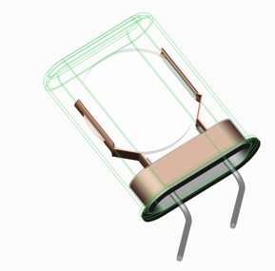
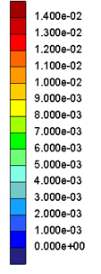
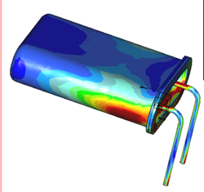
ASIC OCXO challenge
  However getting ppb range OCXO is not matter of thermal sensitivity only…
  Even tough XTAL blank becomes lower, still temperature across package (thermal gradient) remains
  The thermal expansion and contraction due to temperature are bringing some mechanical stress materialized by colors indicating the constraint magnitude [MPa]
T₁ [°C]
T₀ [°C]
Temperature gradient
Mechanical constraints
4-5

Slide 13
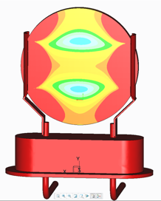
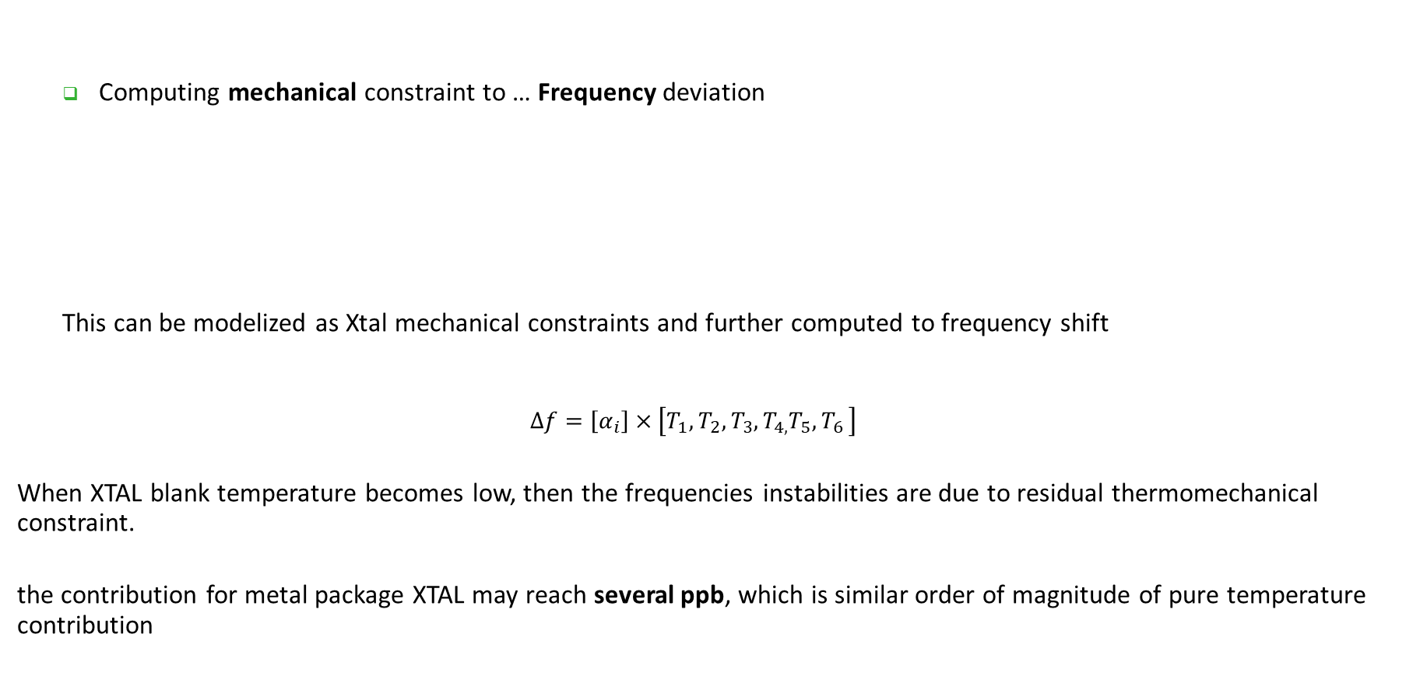
ASIC OCXO challenge
  Computing mechanical constraint to … Frequency deviation
  This can be modelized as Xtal mechanical constraints and further computed to frequency shift
  $$∆f=\left[α_{i}\right]×\left[T_{1},T_{2},T_{3},T_{4,}T_{5}{,T}_{6}\right]$$
When XTAL blank temperature becomes low, then the frequencies instabilities are due to residual thermomechanical constraint.
the contribution for metal package XTAL may reach several ppb, which is similar order of magnitude of pure temperature contribution
4-5

Slide 14
Oscillator topology
  ASIC is integrating multiple functions
  Thermal regulation
  Oscillator circuit
  Output buffer
  Tuning circuit
  Multiple compensation circuit
α+β-γ²
Thermal regulation
4-5

Slide 15
ASIC OCXO challenge and limitation
  Oscillator can be seen as an
  direct amplifier A(jω)
  feedback loop made of bandpass filter B(jω)
  This simple approach is however more complex as the feedback loop is made of:
A( jω)
B( jω)
Δφ
XTAL
Phase shifter
Stop band filter
4-5

Slide 16
ASIC OCXO challenge
  C mode is the oscillation mode but spreading analysis windows show an unwanted B mode
fs
fp
C
C
C
Hp 8752c
RF out
C
RF in
C
C
C
C₀
L₁
R₁
C₁
XTAL
L₂
R₂
C₂

Slide 17
ASIC OCXO challenge and limitation
  B mode limitation due to round XTAL
  Close frequency means that a sharp B mode trap filter has to be implemented
  Need for large external coil with high quality factor
  Temperature sensitivity is ~150ppm/°C
  Load capacitance sensitivity
In addition stray capacitance in the oscillation
loop are inducing frequency shift
4-5

Slide 18
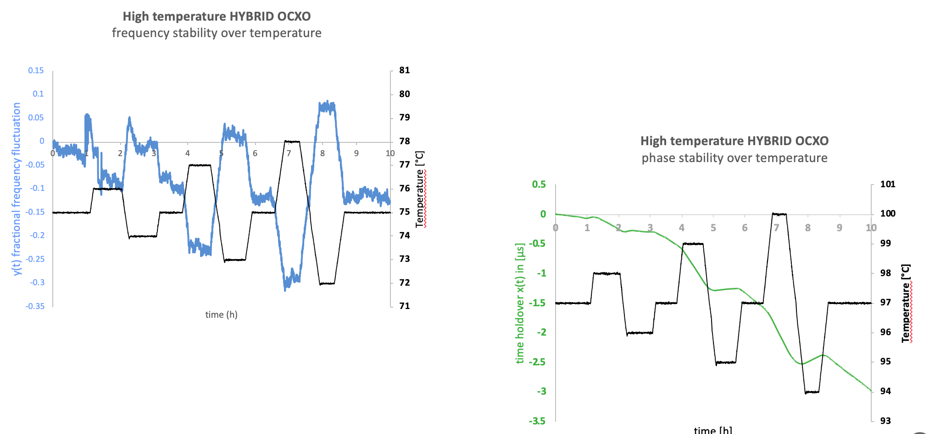
Hybrid OCXO performances today

Slide 19
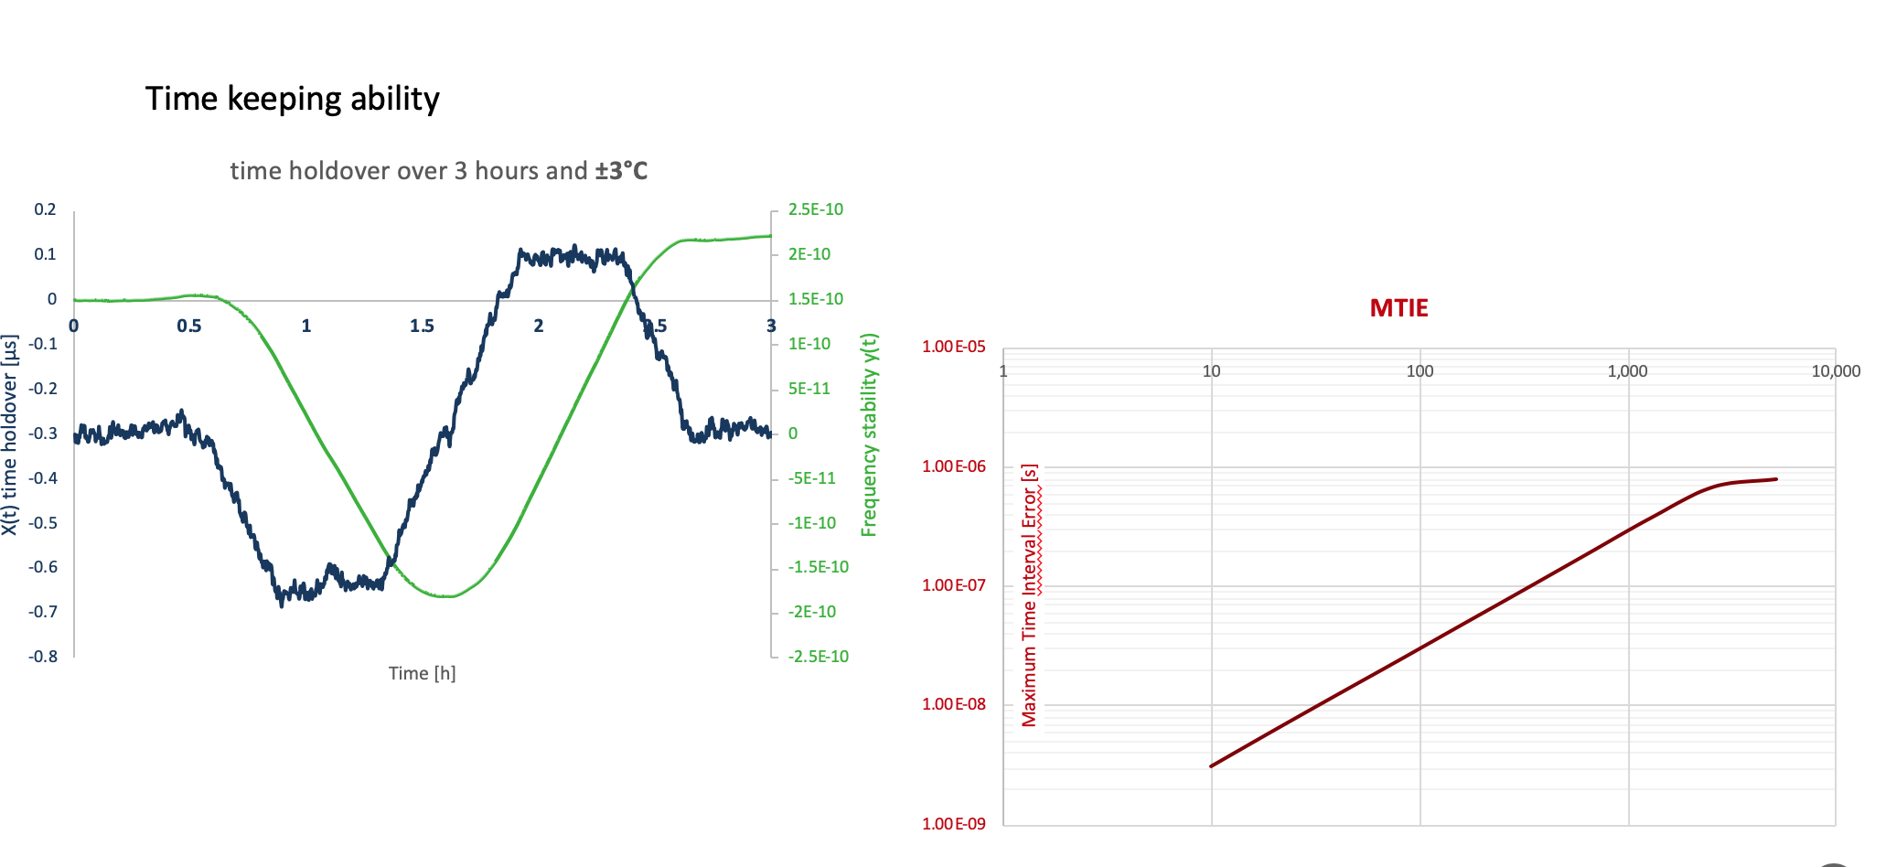
Hybrid OCXO performance overview

Slide 20

Conclusion
  Hybrid OCXO are a technical response to address harsh environmental conditions under high temperature
  Advanced OCXO structure simulation has lead to optimized hybrid structure design
  ASIC based structure is bringing huge benefits with respect to reliability under high temperature
  Metal package XTAL are exhibiting excellent thermal and thermomechanical performances
  µs times holdover may be achieved at high temperature over limited span
  Hysteresis is currently limiting factor further improvement are under progress…
4-5

Slide 21


THANK YOU!
www.rakon.com

